Slide 1
Fyp development slide deck stay strong a narrative game experience
By Joey Wild

Slide 2
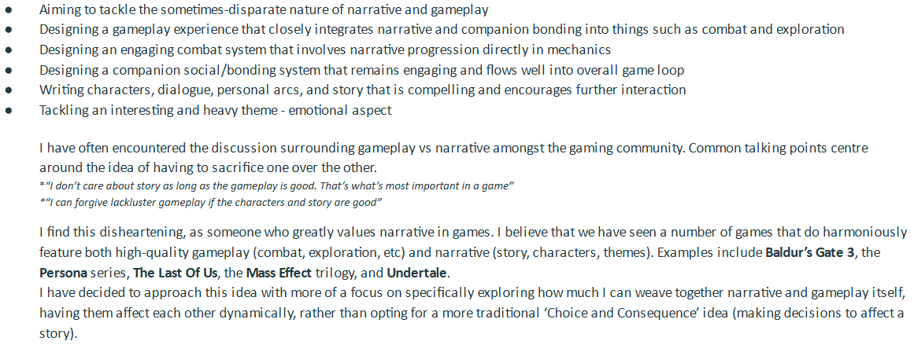
The initial Project problem
The initial problem was addressing the disconnect between conventional gameplay and narrative in games, and creating an experience that forms interplay between the two.
  I was going to approach the project with the main inspirations of Fire Emblem and particularly Persona, implementing a turn-based battle system which is impacted by forging bonds amongst the party members.

Slide 3
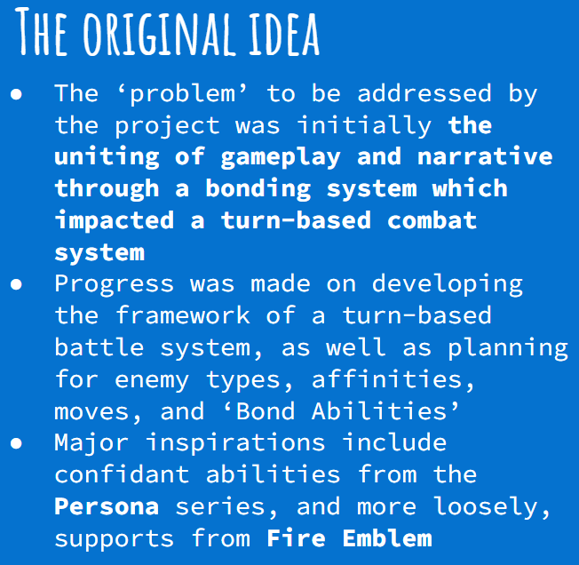
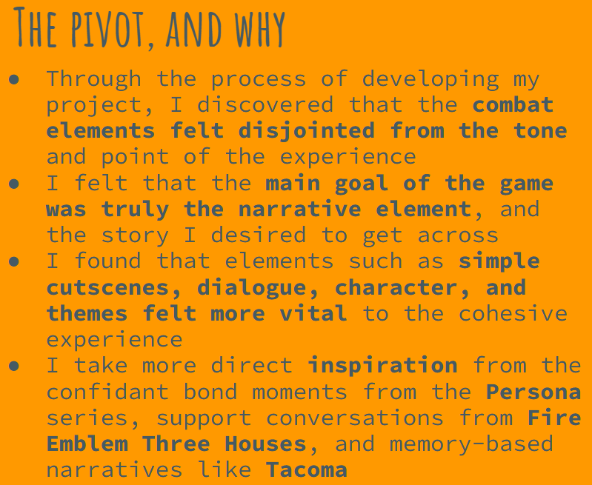
The pivoted Project problem
However, as the development process progressed, I pivoted the problem statement to instead refer to a more metaphorical battle, focusing on an emotional narrative told through memories and effective mood setting.
  The project then came to instead take more inspiration from games such as TACOMA, Gone Home, and Return of Edith Finch.

Slide 4
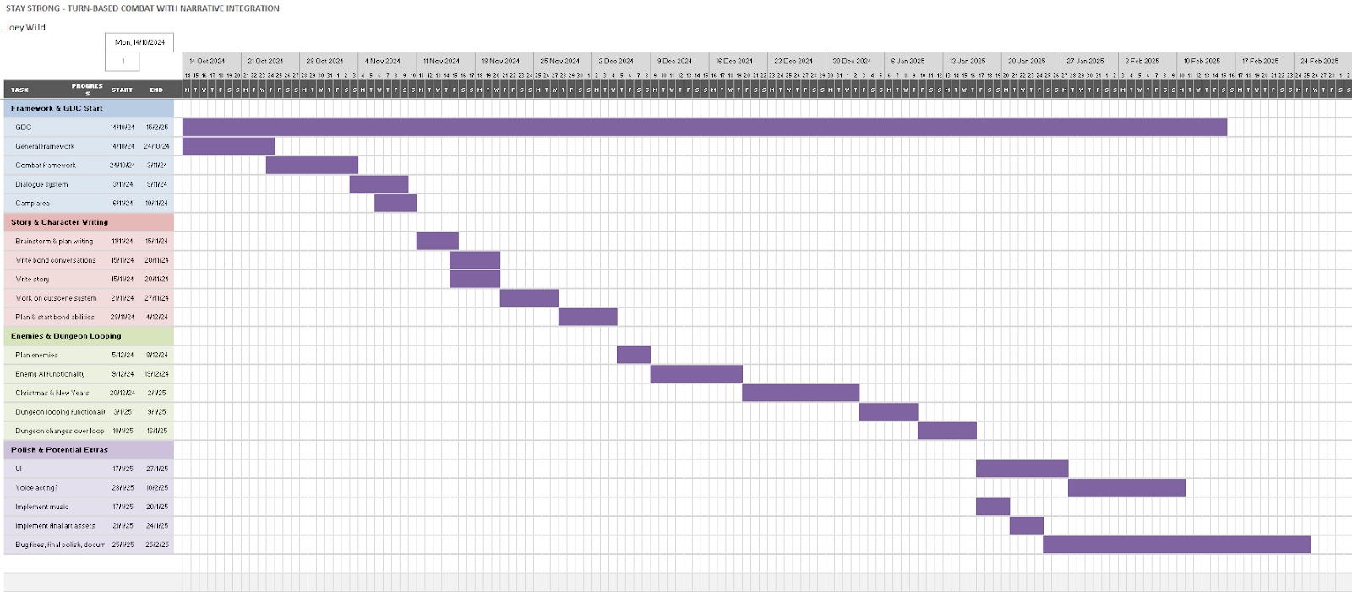
Initial gantt chart
This is the first iteration of my Gantt Chart, at the very beginning of the project development (shown in my proposal)

Slide 5
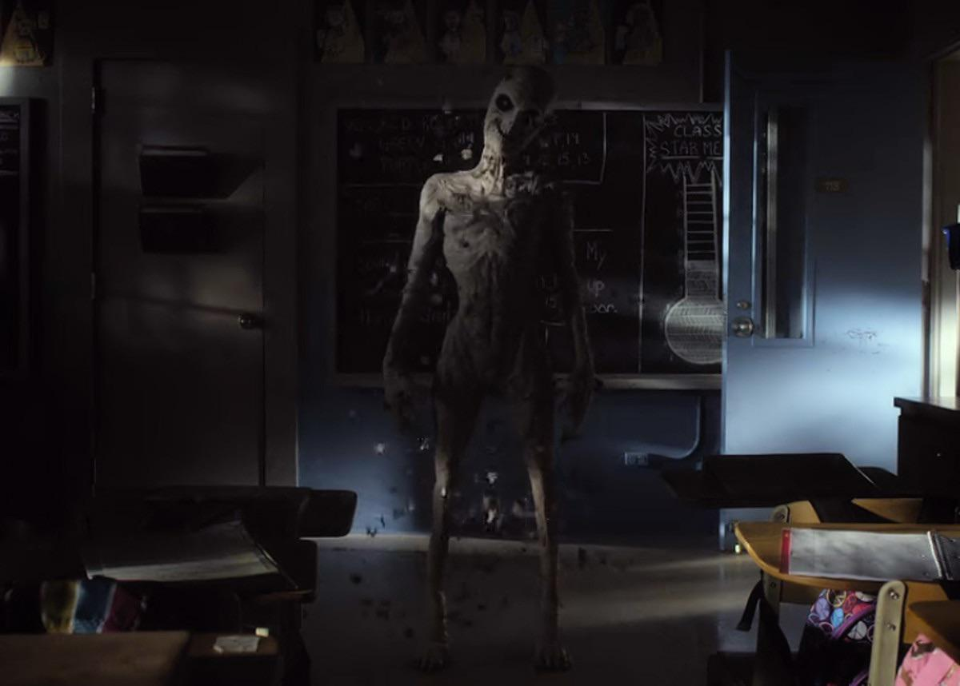
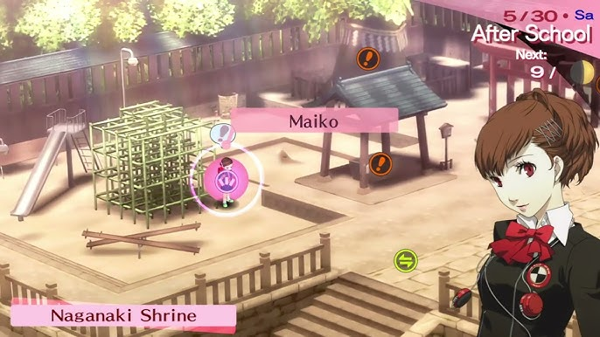
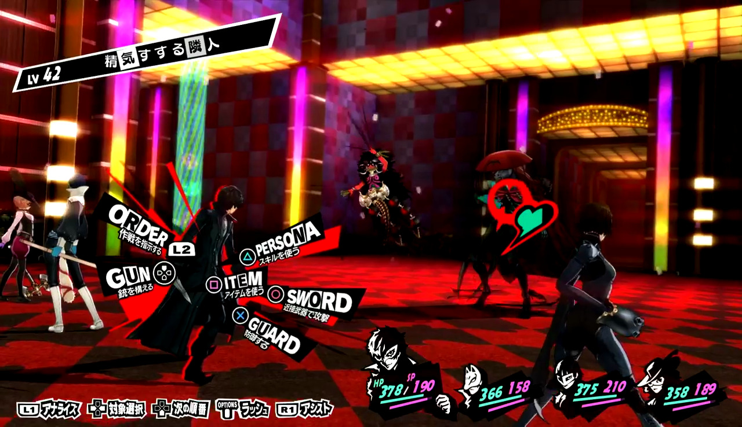
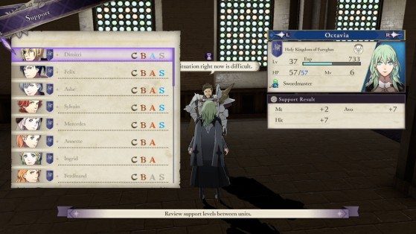
ideation
The initial inspiration chord from the movie “The Canker Man”, which follows a young woman who is haunted by a misshapen demon. It is soon revealed that the demon is a manifestation of her childhood memory of her mother as she was dying of cancer. This struck a chord with me and started forming the first thoughts of being in a child’s mind as they fought an illness and manifested characters from parts of their life.
More game-focused inspirations included Persona (particularly the initial bond-influenced turn-based combat) and Fire Emblem (light effects of supports on combat). Much inspiration for the mind-based setting also came from Persona (mind palaces and metaphorical/mental landscapes)
The Canker Man
Persona 3 Portable
Persona 5
Fire Emblem Three Houses

Slide 6
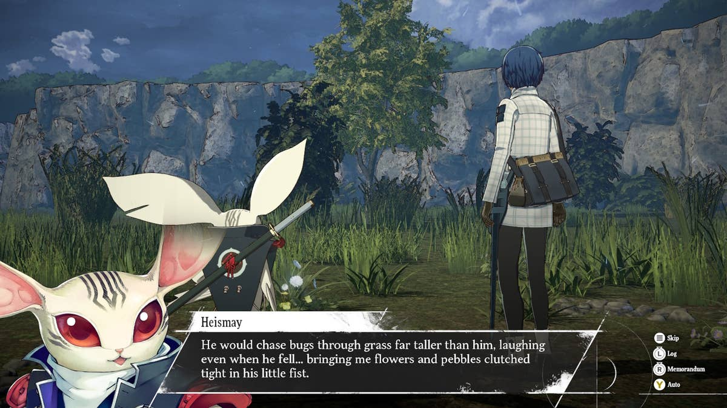
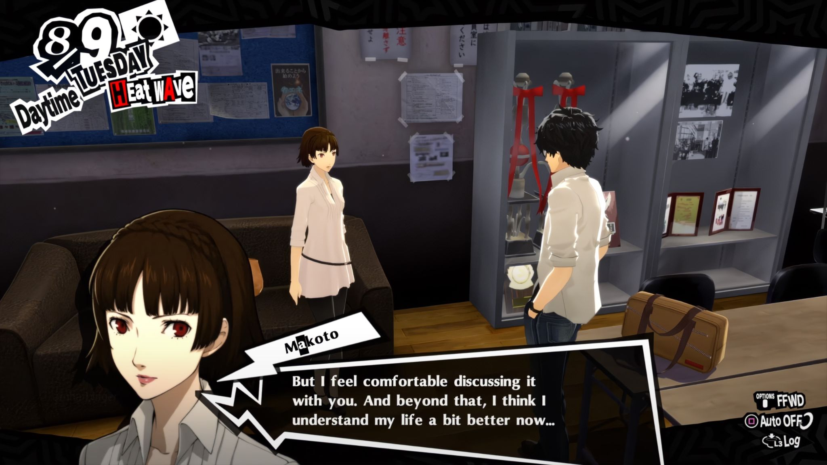
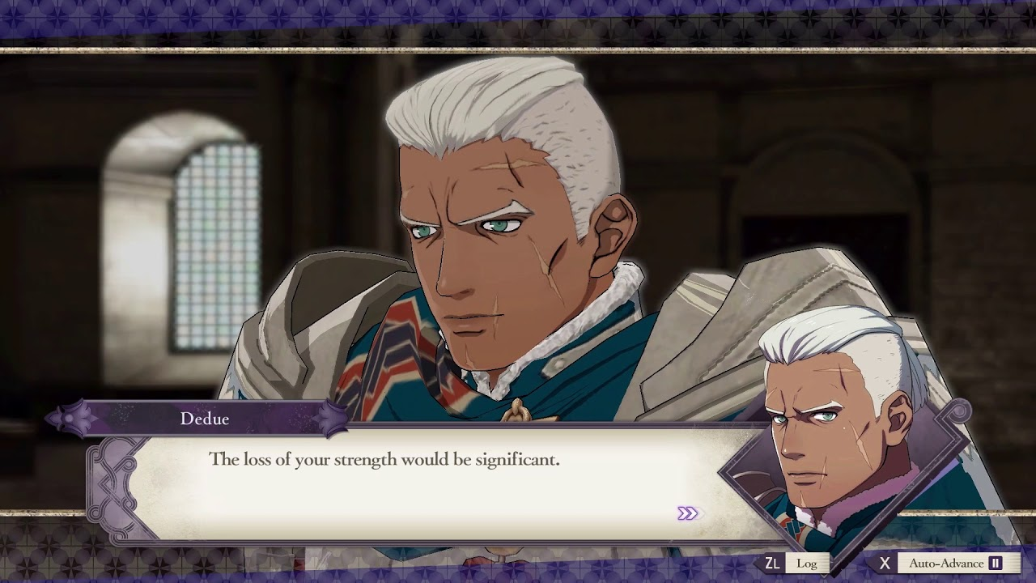
research
Most research took the form of playing and analysing the games which inspired my idea (Persona and Fire Emblem). The game Metaphor: ReFantazio also released in November 2024 (another game by Persona’s developers), which provided more insight in crafting a bonding system.
  I found that pacing, music, character writing, and even UI all contributed to the emotional journey of bonding to the characters as a player, or witnessing the bonds they form amongst themselves
Metaphor: ReFantazio
Persona 5
Fire Emblem Three Houses

Slide 7
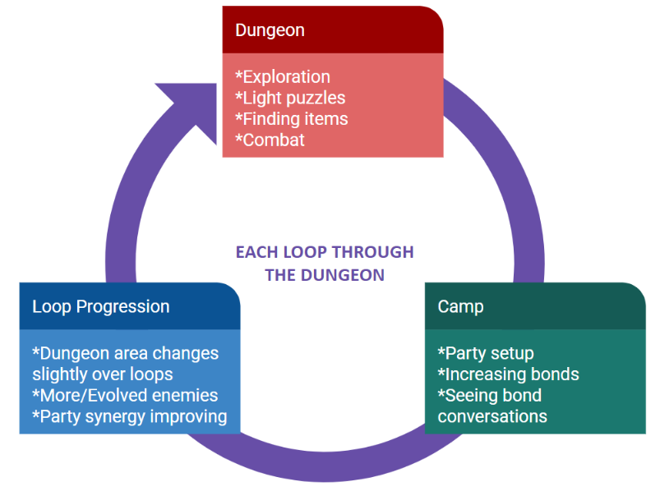
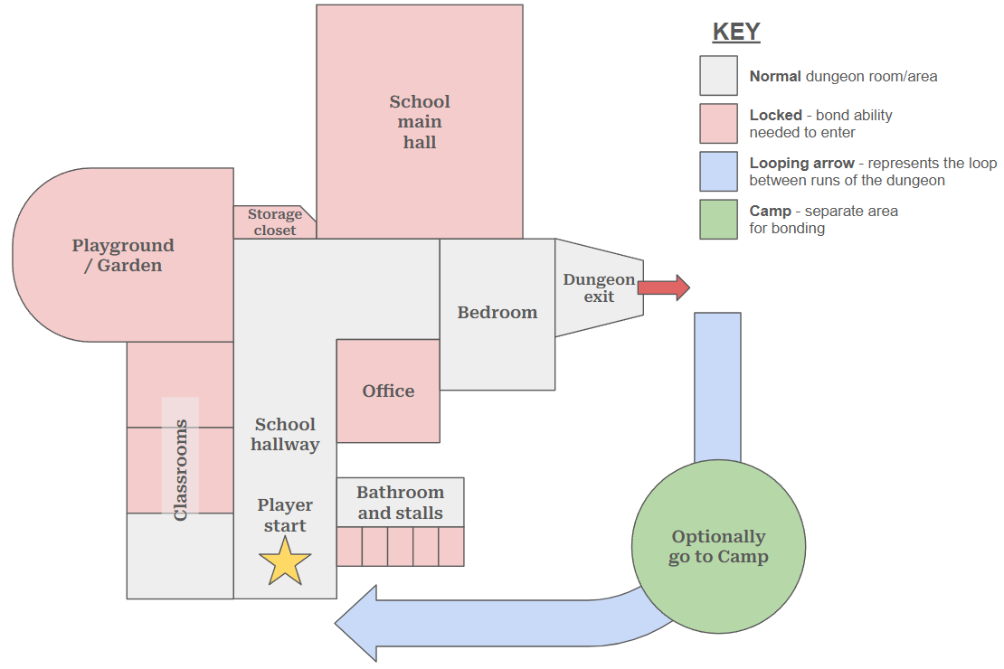
First planning diagrams and map
Crafting the game loop was one of the first things I did, honing in on a cyclical pattern of repeatedly going through a ‘dungeon’ (which is an amalgamate of a school, park, and bedroom), fighting enemies through each run, and resting in a ‘camp’ between each cycle.
A map of the dungeon was also created to help with initial layout planning
Game loop
Dungeon map

Slide 8
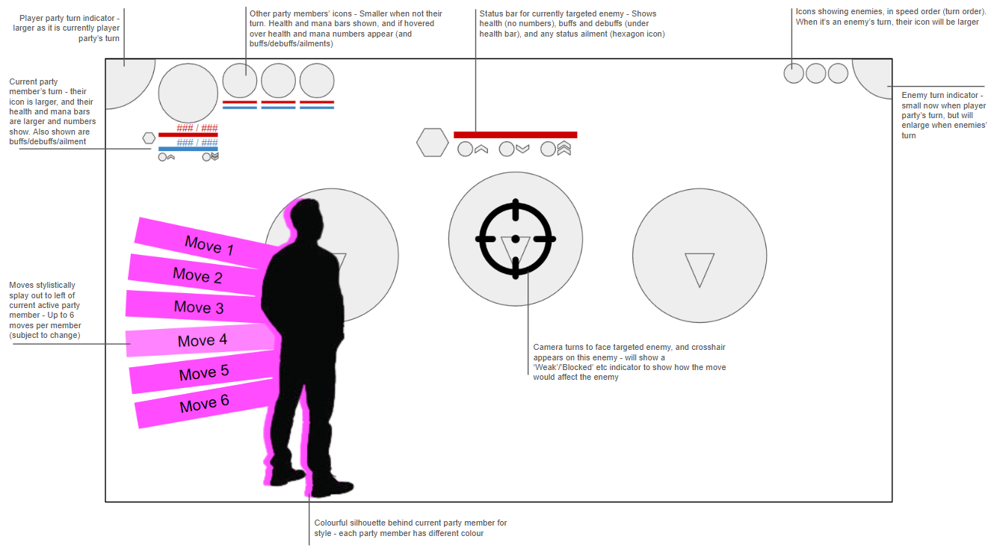
First planning battle wireframe
A wireframe for the UI of the battle system, when that was still being developed and planned to be in the project

Slide 9
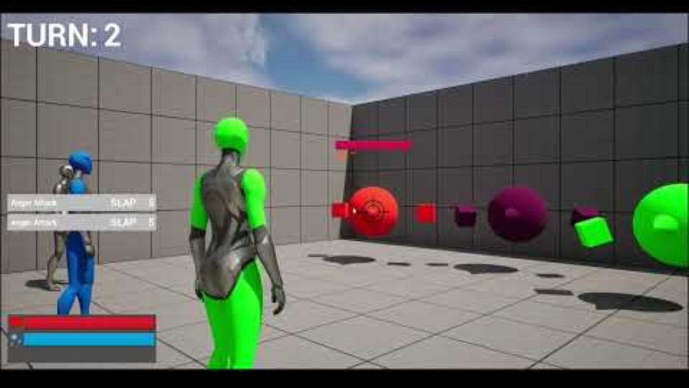
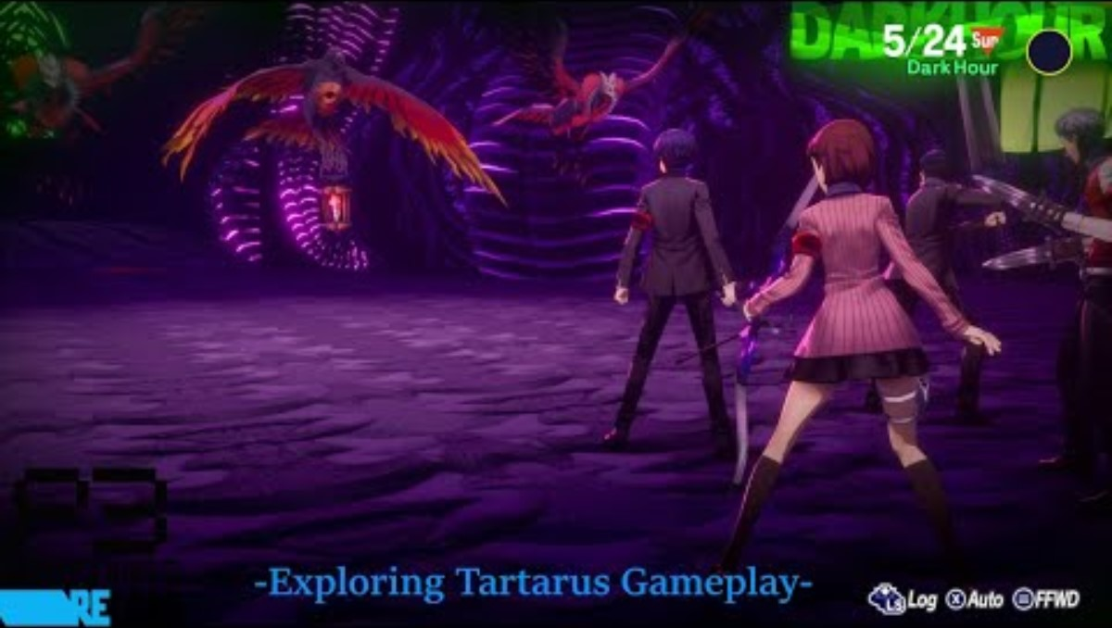
beginning development followers
This is done without using Unreal’s AI system
Apply a simple ‘move to’ node to the 3 Follower actors. The player character has 3 invisible targets behind them, which orient to always be positioned in the triangle formation behind them
This gives the effect of the 3 followers always arranging themselves in that formation
Avoids the followers bumping into / overlapping with each other or the player character
Although, the followers do not have collision with each other or the player, to allow smooth movement and following
Based on the following seen in dungeons in Persona 3 Reload (example below). Progress update at the time shown in video beside that (bottom right):

Slide 10

battle system
When I was still intending to include combat, I had created the foundation of a turn-based battle system, including:
  Functioning turns, based on party member speed order
  Some functioning moves
  UI elements, such as status effects and buffs/debuffs, and health/mana
  Enemies that take their turn
  Working camera

Slide 11
Battle system progress notes
This mainly uses a ‘BattleManager’ actor to oversee variables that need to be shared across all actors (the party members and the enemies)
BattleManager also handles universal aspects such as turn number, switching turns between player and enemy, and triggering passing of active turn between party members
There is a small separate part of the level where battles happen. There may be other versions of the ‘arena’ to accommodate different battles in the game (bosses?)
The actors involved in battle are actually different than the follower actors in the dungeon ‘overworld’. The battle actors are children of the playerChar class, to share functionality
Moves are data assets, with a hierarchy determining move types and shared functionality amongst them. This is done for modularity in creating and implementing many moves
Currently have 1 attack, buff, debuff, and ailment move (just to prototype and showcase), but these can all be used as a basis for all future moves
Characters (and enemies) have stats - Attack, Defense, and Speed - which can be affected by things such as buffs/debuffs, ailments, and the to-be-added bond moves and effects
Enemy moves and AI are to be worked on

Slide 12
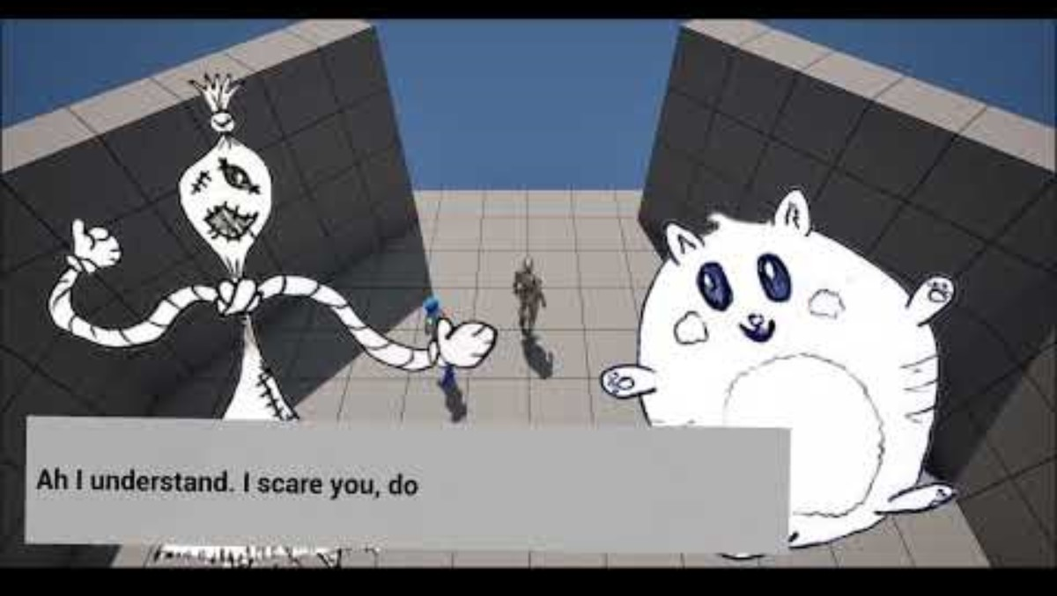
Dialogue system
I then created a modular cutscene dialogue system, for the purpose of the party bonding scenes
  This allows an array of dialogue struct elements to dynamically produce and play a cutscene
  Dialogue box animations are tailored to the speaker
  A ‘typewriter’ function was made with the help of a tutorial

Slide 13
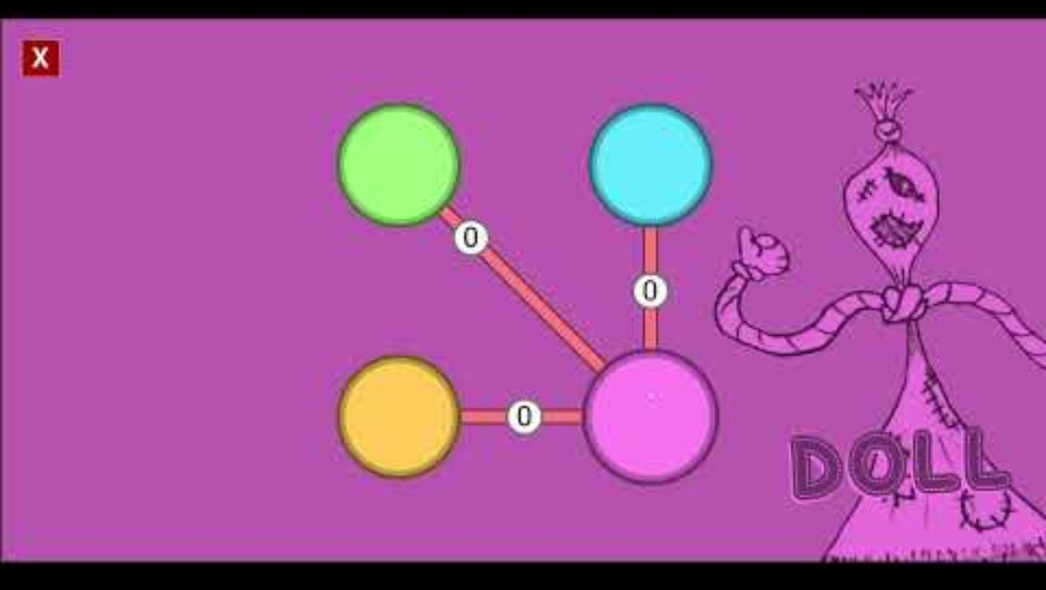
Bonds menu
Another aspect that was cut due to downscoping was the intra-party bond scenes
  For this, I began creating a bonds menu
  This allowed the viewing of bond levels amongst the 4 party members
  This would also show the specific combat abilities members would gain through their bonds

Slide 14
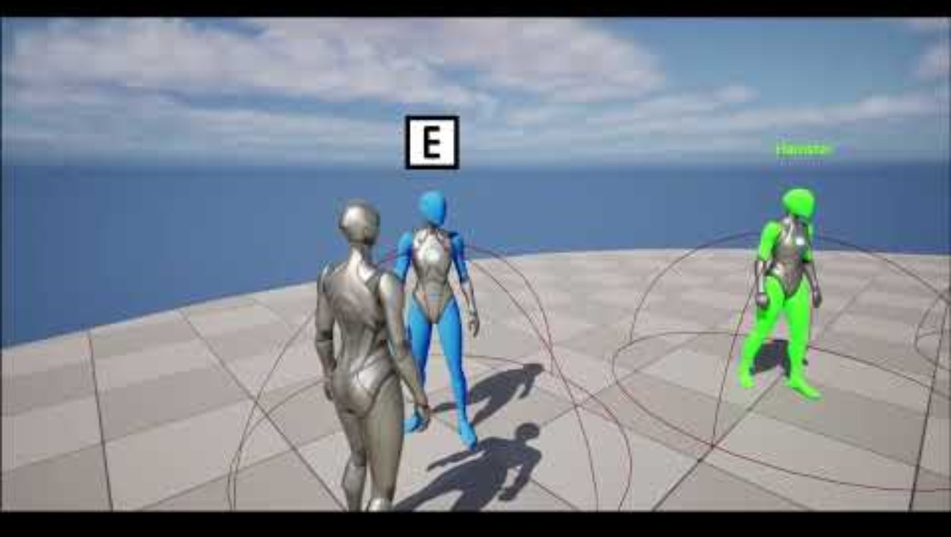
Camp transport
Another cut element of the project that was developed was a camp to enter between each cycle
  It would use a game instance to maintain persistence of important variables (bond levels and cycle number)
  The beginnings of an interaction system in the camp were made, with a simple UI element for ‘E to interact’

Slide 15
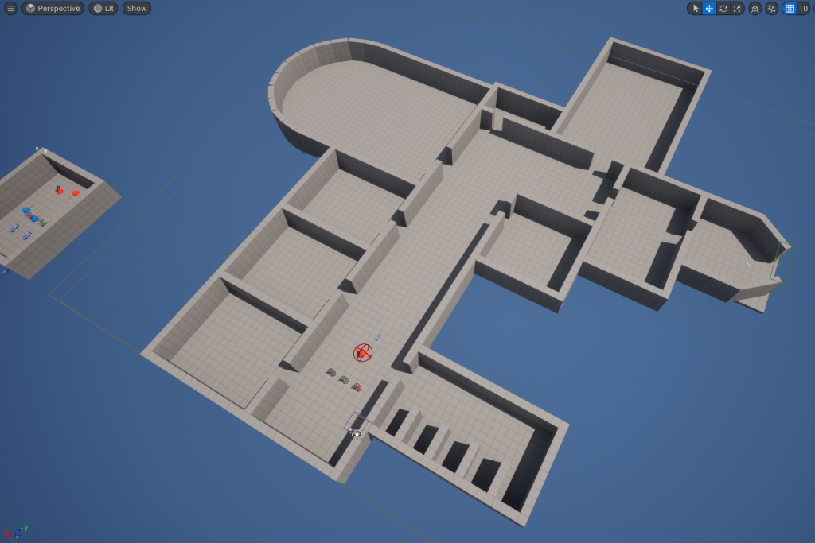
Level blockout
A blockout of the level was done at this point, using the map I created as a base

Slide 16
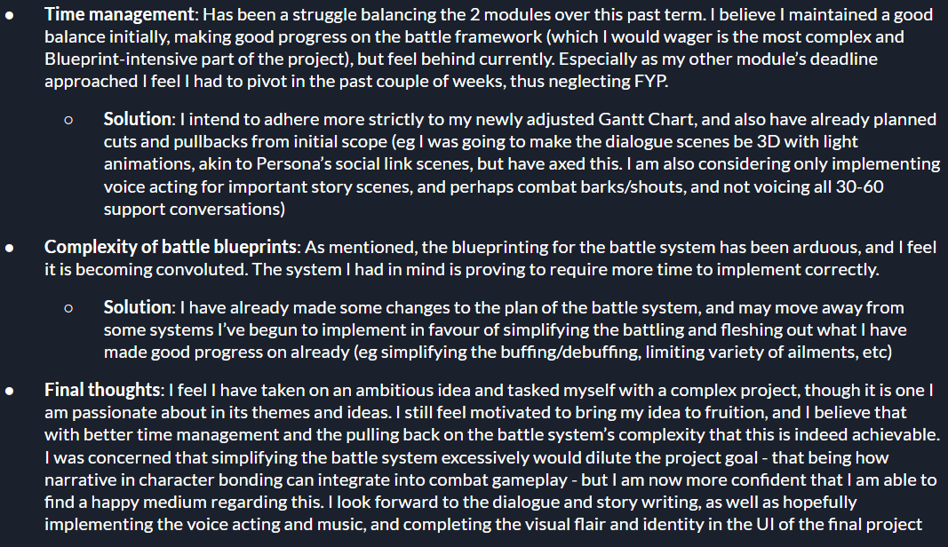
Midpoint progress review
These were the notes I made following my Midpoint review, detailing where I was and how I felt about project progress at thgt time in development.
Note this was just before deciding to cut the combat and camp aspects of the project

Slide 17
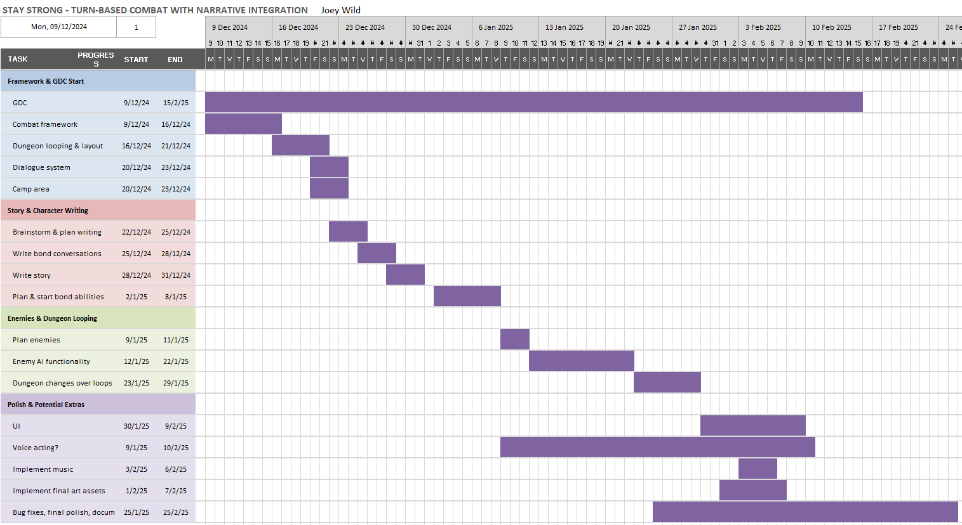
Midpoint-adjusted gantt chart
This is the second iteration of my Gantt Chart, adjusted following my midpoint review to account for my progress at the time

Slide 18
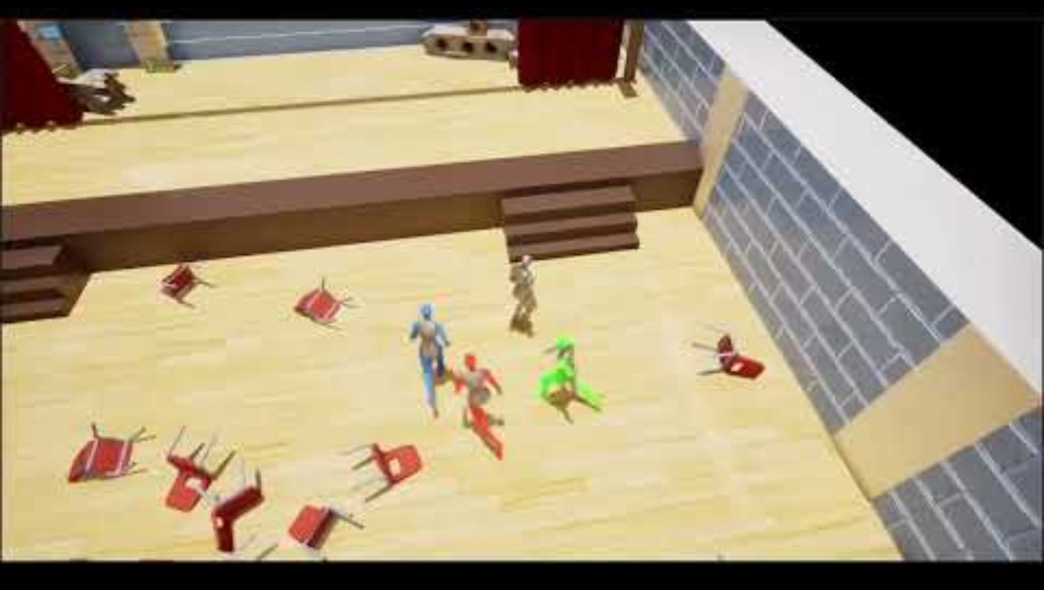
Level mesh out
Shown to the right is the completed mesh out of the level that I had done right after midpoint review.
Also shown is the cut ‘camp’ area, which would have been visited between dungeon cycles. Here is where the player could do activities with the party members and view bond conversations between them
  The dungeon is modelled after a typical school - with a hallway, classrooms, bathroom, principal's office, and hall/gymnasium. However, due to the dreamlike/imagined setting of the dungeon, the layout is 'unrealistically' blended with a park/playground and the kids' bedroom.
  A dark mesh is placed above rooms when they are still locked (as well as doorways being clouded when blocked). The sky/atmosphere itself is dark as well, to create the effect of the dungeon being in a 'blank space' (this was done by editing atmosphere and lighting values). I also eventually include ‘aura’ particles to enhance atmosphere further.
  Also shown is the camp area, which is modelled after a back garden - but again, somewhat dreamlike through having a colourful sky and being set in a forest clearing. The companions are situated where they would be 'hanging out' in the camp (Hamster in the kiddie pool, Robot sitting on the tire swing, and Doll in the gazebo), but animations were planned to be implemented. I also planned to include other actions the player may see them doing (gardening, sitting in tent, using telescope, swinging on roundabout, etc). A day/night phase idea was considered to be implemented in which the player can do one thing in the daytime, and one thing in the night (witness a bond, share a meal, campfire at night, etc).
  As mentioned, while the camp was meshed out, the previous point‘s content was cut in the final project.

Slide 19
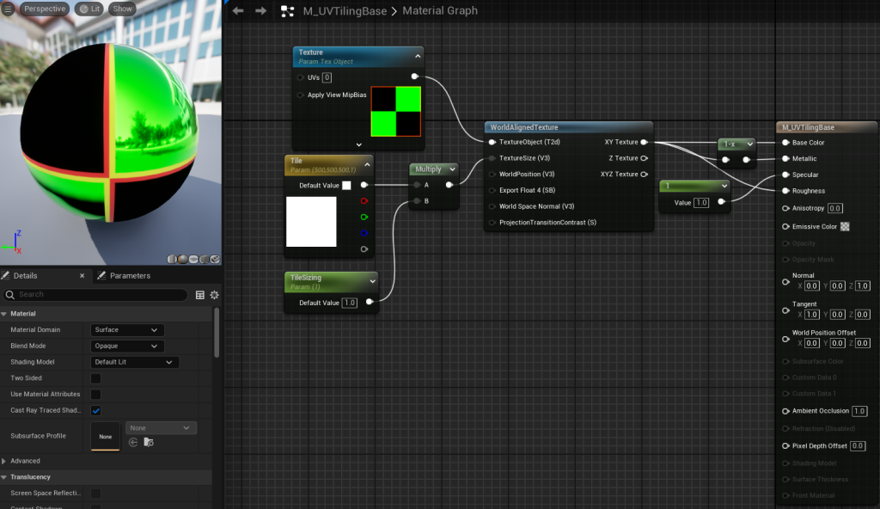
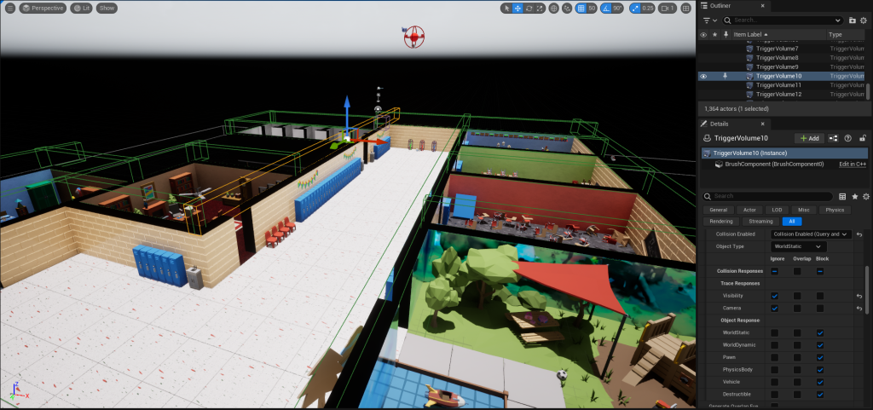
Level design elements
Automatically-tiling material: I created a parent material which uses WorldAlignedTexture to avoid textures stretching as I rescale walls and flooring. This greatly streamlined the process of assigning materials to walls and floors of the level.
Collision boxes to prevent jumping onto and over walls: I discovered that the player could traverse objects to climb the separating walls of the dungeon, in some places. So, to stop this I placed collision boxes which block the player, lining the tops of all the walls. These collision boxes ignore Cameras though (as do all objects in the level), in order to prevent the camera suddenly shifting. This solution became obsolete as I decided to omit jumping from player controls

Slide 20
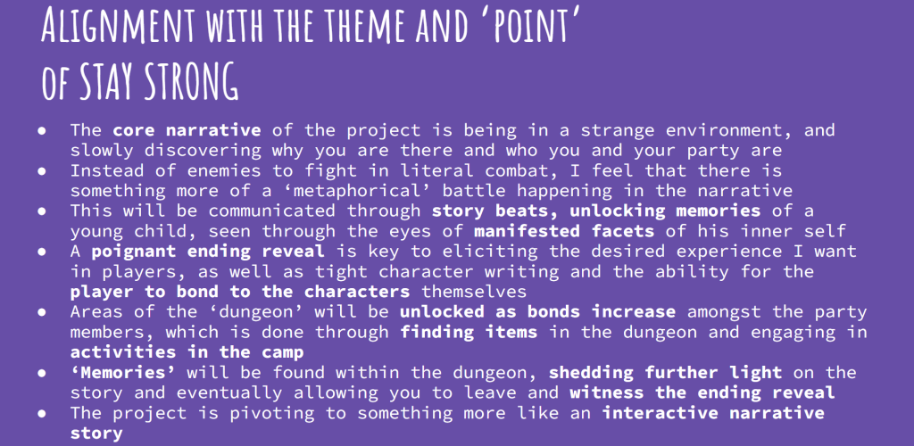
The pivot of the project problem
It was at this point in development that I decided to do the pivot in focus for the project, moving away from the combat-narrative interplay towards an emotional narrative experience.
Notes on this pivot made at the time were shown near the beginning of this presentation (the original and new idea). Further notes on the new goal of the pivot are shown below. (Some elements were still changed or excluded in the final project, mostly the point about activities in the camp / finding items / bonds unlocking dungeon areas):

Slide 21
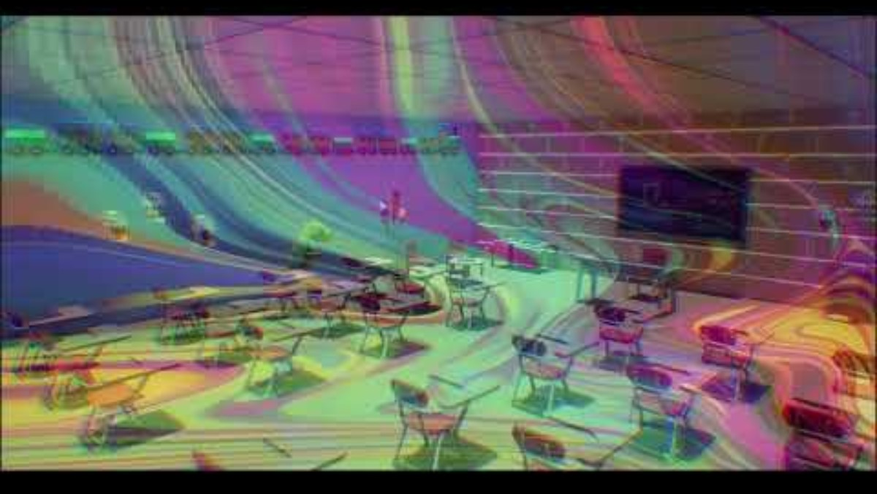
Memory dialogue cutscene
  Given the pivot in the direction of the project, I have altered the game loop to now be the player's party searching for memories in the 'dungeon' landscape. These memories contain short written scenes from the child's mind. Dialogue lines will be colour coded to different speakers.
    A sequence is used to act as the backdrop to the scene, with a dreamlike material overlaid to create the psychedelic/mental effect desired. The sequence also applies gradual colour temperature changes and chromatic aberration to match different emotional ambience for the rooms.
    Memories are not voice acted, but appropriate ambience (emotion-themed music) is implemented.
    Memories are the key behind progressing the story and unlocking more of the dungeon.
    This memory dialogue system is separate from the party-member-bonding dialogue system shown in earlier posts (as those feature character art and unique dialogue boxes for characters).

Slide 22
Narrative planning
  Shown below is the narrative plan I created, laying out both each memory type’s storyline (each step of the memories), and the overall storyline of the game:
ANGER:
Fighting with sister in bedroom - BEDROOM
Playing with sister in park, still fighting, bullies bother the two of them - PARK
Worse fight at home with sister - BEDROOM
You stand up for sister against bullies – PARK
SADNESS:
Sad and alone in bathroom. Hints to something that happened - BATHROOM
Mockery in hallway, more hints to something that happened (clue - mean nickname). Weird kid is there and seems empathetic - HALLWAY
Thing that happened revealed - child peed himself in class - medical problem - CLASSROOM C
Crying in bathroom again - weird kid is there, comforts Gred, helps him grow – BATHROOM
RECKLESSNESS:
Mischievous ‘friend’ urging Greg to get alcohol hidden in storeroom - hint to something - HALLWAY
Mischievous friend and Greg drink in school, Greg throws up in packed classroom, friend runs away and teacher finds them - CLASSROOM B
In trouble in principal’s office, get suspended, mischievous friend keeps making jokes and worsening things - OFFICE
Drinking in park, without friend. Greg runs into old man again. Learning moment, old man talks about how humour saved him and got him through his alcoholism – PARK
FEAR:
Teacher is mean to Greg in class. Mean kids. Greg is anxious - CLASSROOM A
In hallway, teacher pushes Greg to join play. Greg doesn’t want to. Teacher insists. - HALLWAY
Greg during play. Very shy, trips into crowd. Immense mockery and laughter. Greg runs away - GYM STAGE
Greg hiding in bedroom. Parents comfort him. Teach him to stand for himself, despite authority. Greg is inspired – BEDROOM
OVERALL:
Characters appear in dungeon and meet
They find the first memory - talk about it after and what they all just saw
When char finds first memory, first scene introducing the emotion
They consider finding more of these memories
Spotlight moments introducing concepts of the emotion themes of each memory type - attached to each party member
When they find all of the first 4, exit is unlocked
Loop back through dungeon to find more memories. 4 loops total.
Final loop - final spotlights showing conclusion of emotion themes
Exit unlocks final time
Final cutscene in hospital

Slide 23
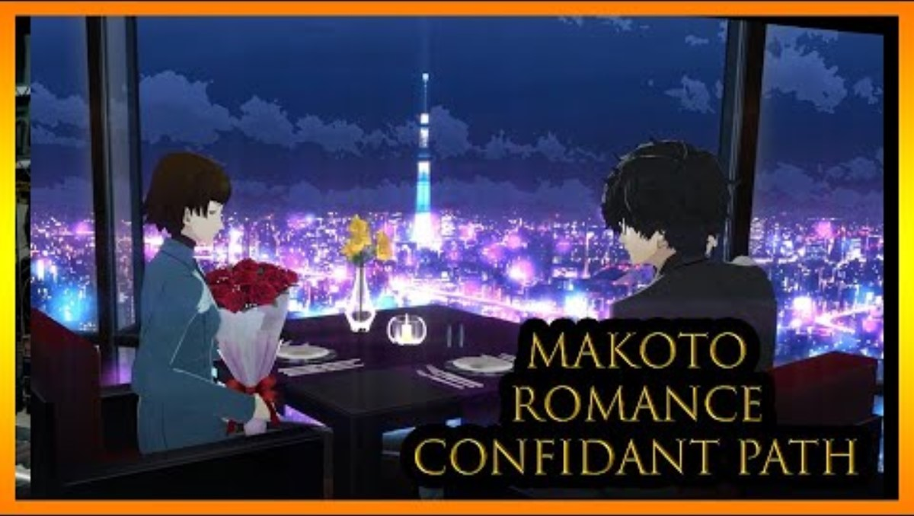
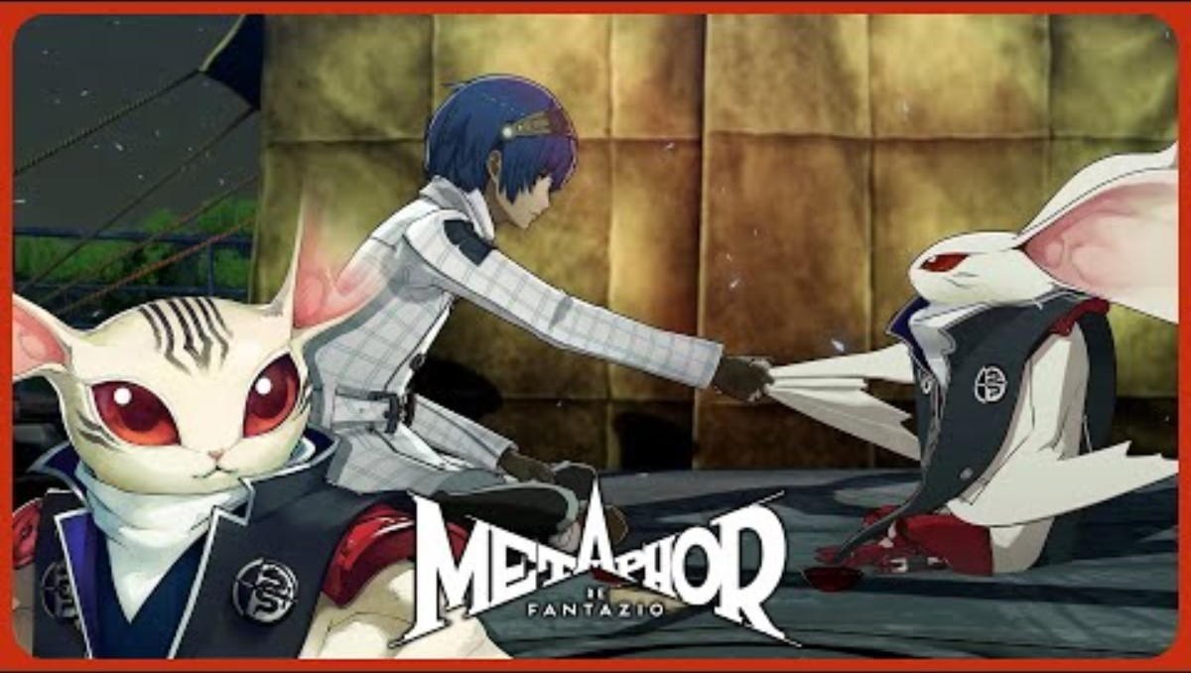
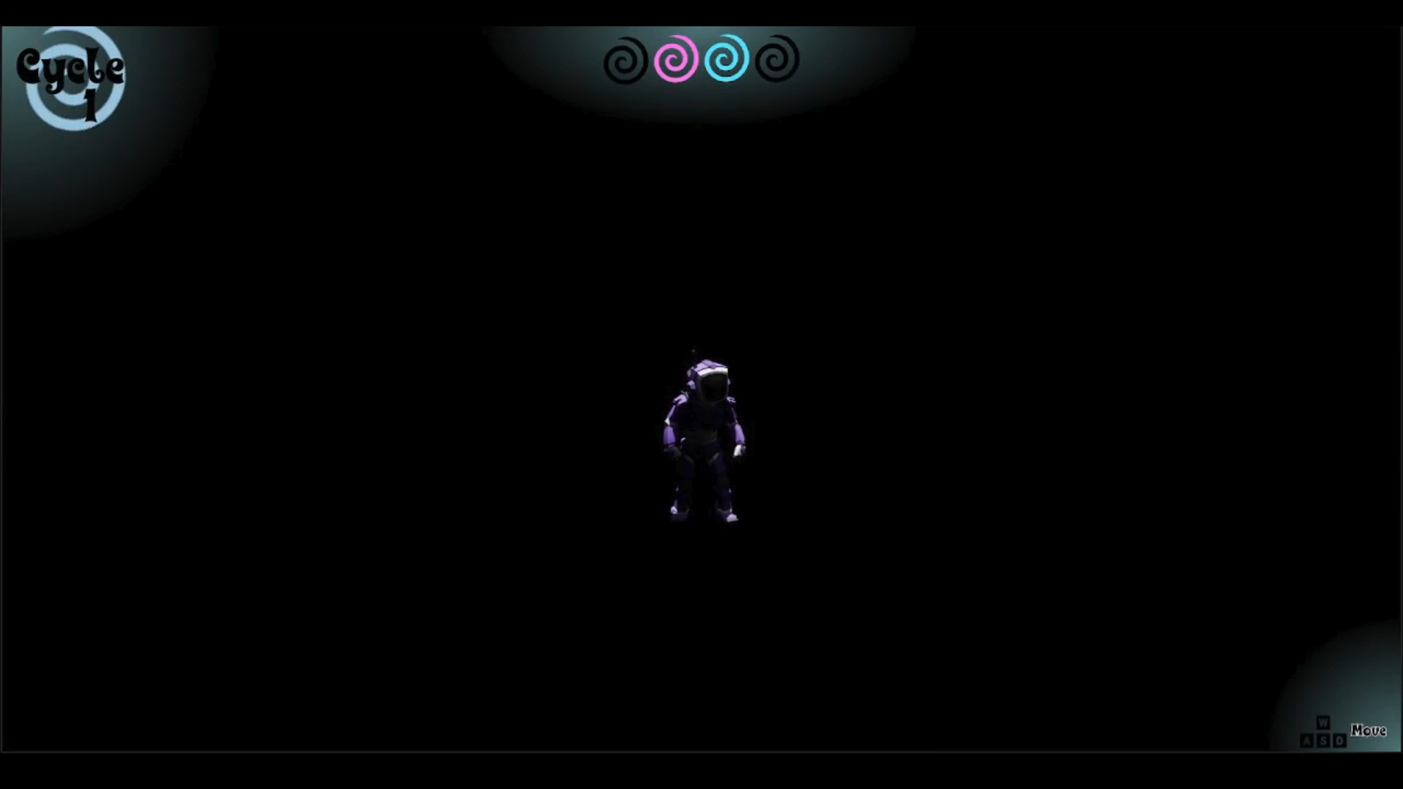
Spotlight moments
  Inspired by the support-start scenes in Persona 5, and the bond formation moments in Metaphor ReFantazio, I created a scene which plays for the first and final memories of each emotion theme to illustrate said theme in a dramatic and poignant way.
  The scenes are narrated by my parents
  Bottom left and centre are inspiration examples, and bottom right is a spotlight scene from the project

Slide 24

Hospital sequence ending & credits
  The hospital ending is pivotal in communicating the ‘point’ and narrative theme of the game. It is essentially the ‘reveal’ of having been in the mind of a terminally-ill child.
    Hints are present throughout the game, such as the constant heart monitor beeping, the mother’s voice periodically heard in the background, and the characters being emotional manifestations
    It is also revealed that the characters were based on real-life toys, drawings, and a pet from the boy’s life
    Further voice acting from my parents, and a fellow student (Alex Pointon) is present
    The scene is created through a level sequencer (as the memory backgrounds and spotlight moments were)
  This scene is immediately followed by the credits, made through UI animations
    Credits of known people involved in the project
    Timing was important for the hospital scene itself, credits appearing, and the start of emotional music following the hospital scene

Slide 25
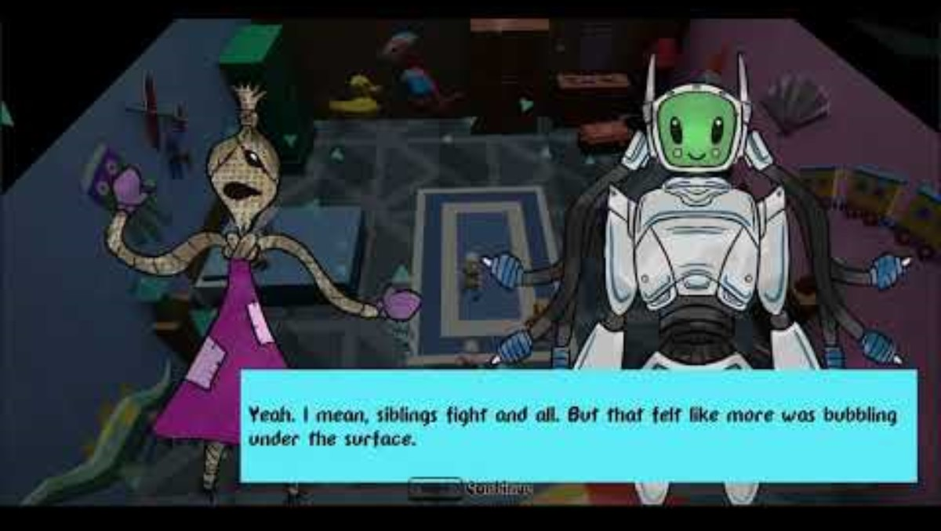
Showcase playthrough

Slide 26
List of cut content
  KEY: WAS DONE, PROGRESS WAS MADE, NOT BEGUN
  The combat element
    A turn-based combat system
    Enemies spawn in the dungeon through each cycle
    Small variety of enemies
    Movesets for party members and enemies
    Final boss at park pond
  Bonds amongst party members
    Dialogue system and screen (used for general story moments, and memory reactions)
    Bond levels and conversations amongst party members
    Bonds affecting combat through abilities
    Bonds unlocking parts of the dungeon (instead areas unlock through cycles)
  Dungeon elements
    Dungeon changing slightly through each loop (ambience change)
  Camp elements
    Meshed out camp area
    Activities to do in camp

Slide 27
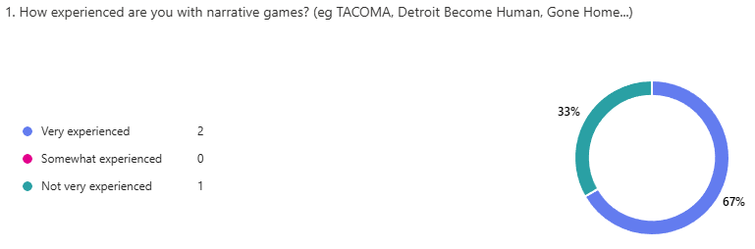
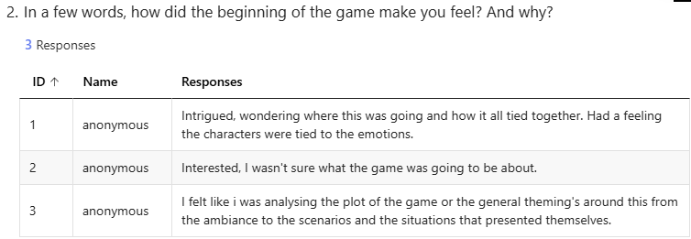
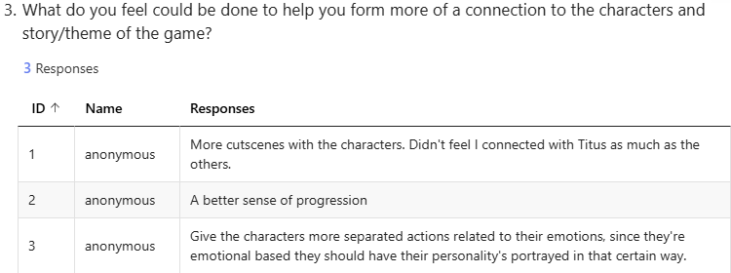
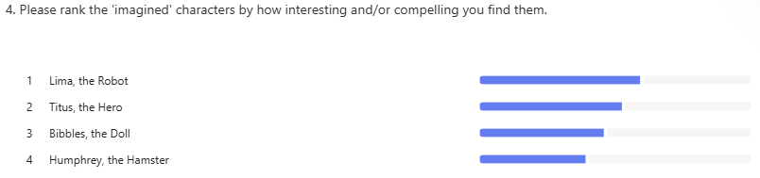
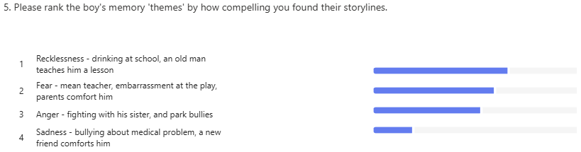
Testing feedback
  I engaged in limited testing at the end of project development, collecting data from 3 people
    This limited number is largely due to the long length of the game, averaging about 20 minutes
  Intrigue, interest, and analysis were the general sentiment of testers at the beginning of the game.
  Criticism around improving connection to characters and theme were mixed, with expected elements such as more cutscenes and better progression of character story cited, but also wanting more clear alignment between characters and their associated emotional theme
  Lima the robot was generally received best, while surprisingly the comedically-written Humphrey the hamster was a least favourite. Perhaps players preferred more comforting and grounded characters amidst the more serious tone of the game?
  Interestingly, the emotional themes were relatively closely ranked (with the recklessness storyline being a favourite), however the sadness storyline was noticeably ranked least favourably. It may require more fleshing out to align more with the other themes

Slide 28
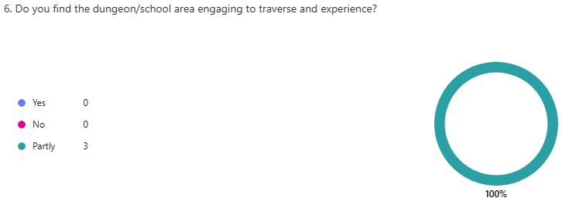
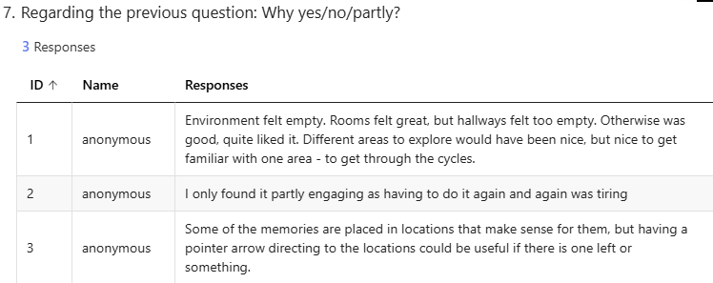
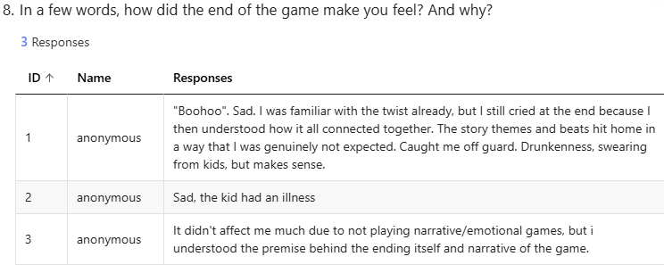
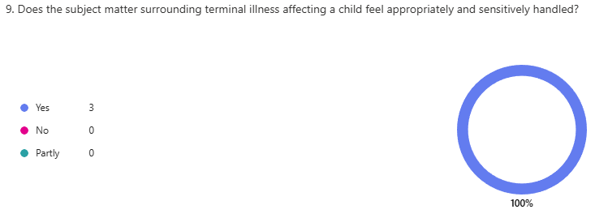
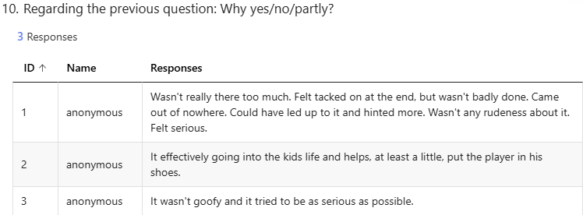
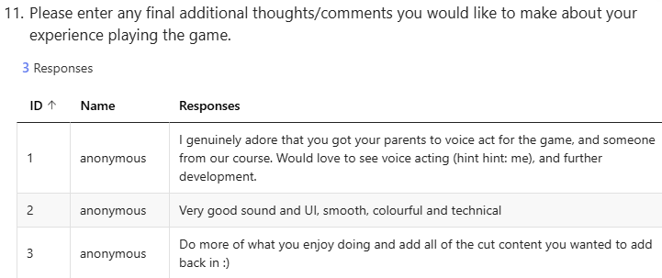
Testing feedback
  All testers answered ‘partly’ when it came to engagement with dungeon traversal. Reasons generally focused on repetitiveness, emptiness, and lack of more areas. This was expected due to downscoping and cutting of the camp especially
  It was generally consistently said that the end of the game elicited a sad reaction, which was the goal
  It was completely agreed that the subject matter of the ending was handled well, due to no silly elements and serious tone
  A consistent point made in the final comments was eagerness to see further production, and inclusion of cut elements. UI and sound design was praised as well, which is ideal due to that being a focus of the project as well

Slide 29
Critical reflection
  Overall, I am pleased with the final product, for the most part.
  I feel that it does achieve the new pivoted goal of ‘showcasing a metaphorical battle, focusing on an emotional narrative experience’.
  I do regret the many cuts due to necessary downscoping. Elements that were criticised in testing feedback would have been addressed by some of the cut content.
  I feel that I did a good job with UI, sound design, level meshing, sequencer use, and creating an appropriately hard-hitting final ending cutscene. I also enjoyed implementing voice acting, and writing/designing the ‘spotlight’ moments.
  While I feel that the writing is adequate, I would have liked to have done better with it. Though it could be said that it is moreso that more dialogue content to bond with the characters better would have helped, rather than the writing itself.
  The repetitiveness is also a criticism I have for the project, as again, the cut content trims it down to mostly traversing the same area repeatedly.
Reference list
Craig Perko (2022). Typewriter Text in Unreal (Visual Novel Dialog Effect). [online] YouTube. Available at: https://youtu.be/uqtiH_FnqOc Tutorial used to create typewriter effect of dialogue text.
Pixabay (2024). Pixabay. [online] Pixabay.com. Available at: https://pixabay.com/ All sound effects and music from here.

